Slide 1
Hardfire: Critical Response to Tony Szamboti
Ryan Mackey
September 2009
1

Slide 2
Legal
This work is Copyright 2009 by Ryan Mackey. All rights reserved. All opinions are the author’s alone and do not represent any agency, public or private. Photographs are used in accordance with Fair Use guidelines and may be subject to their own copyright protection. The author can be contacted at: rmackey_email@earthlink.net
Additional On-Line Resources:
9/11 Myths: http://www.911myths.com
Mark Roberts’ Pages: http://wtc7lies.googlepages.com/
9/11 Guide: http://911guide.googlepages.com/
2

Slide 3
Why does Balzac-Vitry experience a “Jolt?”
Verinage demolition technique
All columns on the collapse floor were broken in unison to control debris field
Concrete structure with relatively heavy and strong floor systems
Upper portion falls distance of two floors without any significant contact
Drop was followed by a square, uniform impact between portions, with no visible tilt

Slide 4
WTC 1 and 2: No Jolt! Why?
Support columns did not fail simultaneously
Both collapses begin with a significant rotation, not a sudden fall
This rotation gradually breaks the “hinge” causing a gentle transition to vertical collapse
Most contact points are floor structures – light weight and springy by comparison
Columns and large chunks of debris would pierce floors at essentially unpredictable times

Slide 5
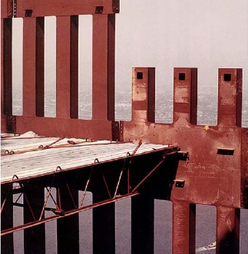
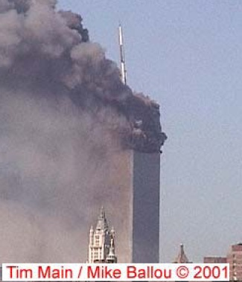
WTC 1: Tilt onto Floors Below
Figure 2-17, NCSTAR1-1
Figure E-11, NCSTAR1-6D
3

Slide 6
WTC 1: Visualizing Tilt
~ 8º
Video confirms the upper block rotated before falling
Thus, there are no square impacts
Floors fail gradually across their width, all the way down the structure
4

Slide 7
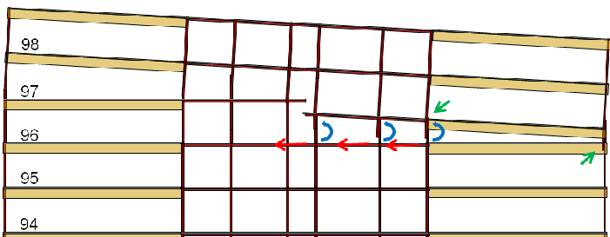
WTC 1: Evolution of Tilt
No rotation
3º rotation
5
Figure Credits: Gregory Urich, JREF Forum

Slide 8
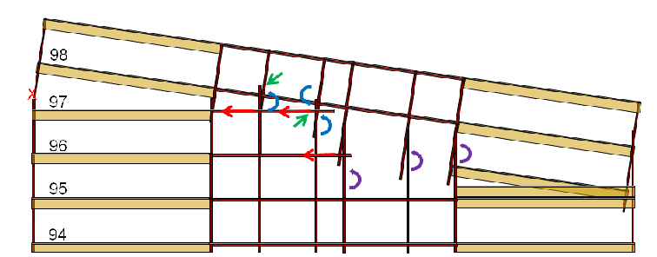
WTC 1: Evolution of Tilt
6º rotation
8º rotation
6

Slide 9
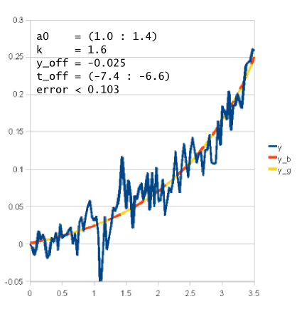
WTC 1: Fitting Antenna Motion
Graph shows early displacement of WTC 1 antenna vs. time
Period immediately before Tony’s graph
Curve fit matches a rotation caused by buckling perimeter wall
Meters
Seconds
Graph Credit: Poster OneWhiteEye
http://the911forum.freeforums.org/
wtc-1-collapse-initiation-t172-30.html
7

Slide 10
How Could We Prevent A Jolt?
Suppose for sake of argument Mr. Szamboti is correct
If true, WTC 1 and 2 must have been damaged so that the upper block never contacted the lower floors
Can we destroy the lower floors before the upper portion arrives?
No! In this case, the upper portion will never be slowed at all, and hits bottom in roughly 9 seconds.
The lower structure absorbs energy roughly equal to 40 tons of TNT equivalent. Without this, the collapse will happen too fast!
Nothing other than the lower structure could possibly slow down the upper portion

Slide 11
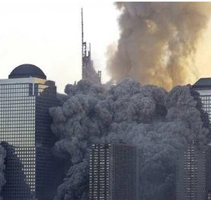
WTC 1 and 2: Surviving Core Structures
In both collapses, building cores were the last pieces left standing
Shown: WTC 1 collapse
Core remnant is approximately 70 stories in height
Clearly, the cores were not destroyed by explosives
8

Slide 12
WTC 1 and 2: Evidence Against Demolition
Mr. Szamboti’s hypothesis requires nearly every column connection to be deliberately destroyed (explosives?)
NIST recovered many columns, with intact ends, from the debris
None of them were destroyed by explosives
True for both perimeter and core columns
In fact, absolutely no recovered steel of any type shows signature marks of explosives

Slide 13
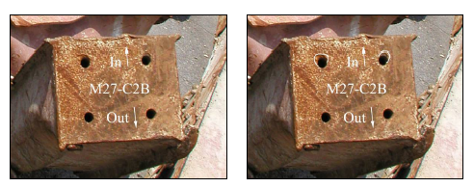
Recovered Perimeter Columns
Figure 3-47, NCSTAR1-3C
Perimeter column from
WTC 1 Floor 92
Figure 3-42, NCSTAR1-3C
Perimeter columns from
WTC 1 Floors 90-93
9

Slide 14
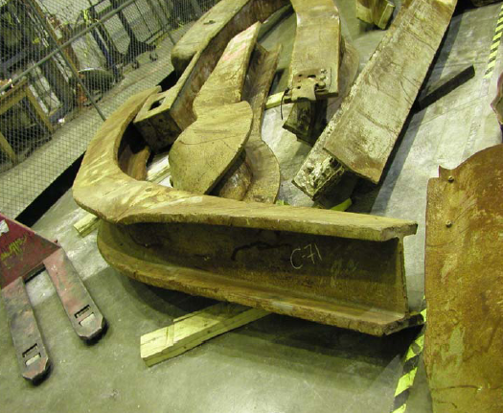
Recovered Core Columns
Figure 3-12e, NCSTAR1-3B
Recovered core columns
from WTC 1
Figure 4-1, NCSTAR1-3C
Core column from
WTC 1 Floors 92-94
10

Slide 15
WTC 1 and 2: More Evidence Against Demolition
Both towers were visibly and gradually damaged as the fires burned
How could this be the work of explosives?
If fire can weaken the structure, why can’t fire weaken it to failure?
If explosives were used, why did the core fail last? How was it brought down without damaging the core?

Slide 16
WTC 1: Gradual Deterioration
Figure 5-6, NCSTAR1-6D
Inward bowing of
WTC 1 perimeter
Eight minutes before collapse
Estimated up to 55 inches of
perimeter deflection
11

Slide 17
WTC 1: Fireproofing
NIST does not predict all fireproofing on far side from impact removed
Only where fuselage went through, and some went through at very high speed
Evidence, the opposite section punched out at impact
Also, many researchers have calculated that even with intact fireproofing, collapse was inevitable
Collapse started on that side due to prevailing winds, pileup of combustibles, and longer floor trusses. This was the weakest point. (verify side)

Slide 18
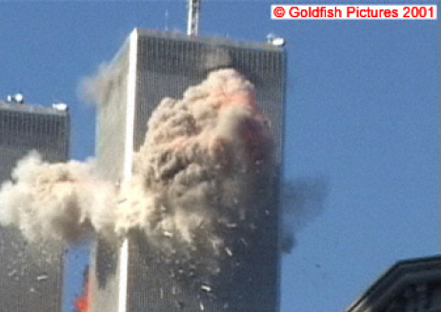
WTC 1: Fireproofing Damage
Figure 6-1, NCSTAR1-5A
WTC 1 Impact + 3.5 seconds, North Face
Figure 9-5, NCSTAR1-5G
WTC 1, Floor 96, Case B
12

Slide 19
WTC 1 and 2: The Wedge Hypothesis
After the first few floors collapse, most of the interface is rubble – amorphous, heavy, and moving fast
Tends to slide away from the heavier core, falling to the side and landing on the truss sections
This breaks and shears off the trusses and pushes perimeter columns and spandrels outward
Core beams are sitting on welded seats, but beams themselves are not welded to the columns and lift out easily
Lower core resists impact, but upper core falls apart
This mechanism hits the structure in a way it was never designed to withstand, so the strength of the structure has little effect on the collapse
Consistent with recovered perimeter sections and survival of core remnants

Slide 20
The Wedge: Phase 1
At collapse initiation, a perimeter wall buckles, and the upper block begins to rotate about a hinge
Rotation of about 8-10 degrees
Crushes several floors opposite the hinge
This phase takes about 1.5 seconds

Slide 21
The Wedge: Phase 1
13

Slide 22
The Wedge: Phase 2
After rotating about 10 degrees, the “hinge” fails completely
Upper portion now falls as a free body
Tilt angle, however, channels rubble and mass mostly inside the perimeter columns
Exerts an outward pressure on those columns, shearing their bolted connections

Slide 23
The Wedge: Phase 2
14

Slide 24
The Wedge: Phase 3
Over time, the core resists better than the floors and perimeter
Core is weaker when hit from below than against top impacts, so the upper core begins to break up
Surviving lower core channels debris to the sides, increasing the load on floors, which buckle and snap free
Some of core survives until after the outside is completely stripped away

Slide 25
The Wedge: Phase 3
15

Slide 26
WTC 7: Should there be a “Jolt?”
WTC 7 suffered an almost total internal collapse before the perimeter started to fall
Not at all like Balzac-Vitry or any of the verinage cases
Perimeter behaves like a thin shell buckling under its own weight – a total system failure, not a floor-by-floor failure as in WTC 1 and 2
There is nothing substantial for the perimeter remnant to hit until it has descended out of view
Outer shell may buckle all at once, or may buckle in stages – each one leading to a “jolt.” Maybe.

Slide 27
WTC 7 vs. Beijing TVCC Fire
WTC 7:
All steel structure
No firefighting possible
Burned for over seven hours
Long-span steel beams between core and perimeter
Fire ventilated by impact damage
TVCC Building:
Reinforced concrete with internal and external fire-resistant cladding
Vigorous firefighting, under control in about one hour
Braced tube “superstructure” needing no stabilization from floor spans
Unoccupied and low fuel load
Specifically built with lessons from WTC 7
16

Slide 28
TVCC Fire, Continued
Massive concrete frame visible from construction photos
Concrete cores are typical of all post-September 11th skyscrapers
Despite precautions, building was heavily damaged by fire anyway
Photo Credit: Tom van Dillen,
www.vandillen.net
17

Slide 29
Summary: Why do we disagree with Mr. Szamboti?
Presents no clear, testable hypothesis for how the Towers could have been sabotaged
Demolition is unnecessary – many published results prove the Towers were expected to collapse completely
“Missing Jolt” argument ignores details of the collapses that complicate the situation
Early rotation of upper structure or internal collapse
Descending mass primarily hitting truss-framed floors, not load-bearing elements
Comparisons to verinage situations are not appropriate
There is no evidence in favor of sabotage
There is considerable evidence against sabotage
18

Slide 30
Summary, Continued
Now pretend the WTC was sabotaged
How did the devices get there?
Why are there no recorded sounds of explosives?
Why weren’t thousands killed by flying glass?
Why did occupants and security fail to detect them?
Why would anyone plant them in the first place?
Why is there no support at all for this hypothesis in the scientific and engineering community?
The idea depends on numerous leaps of faith, and raises more questions than it solves
This is typical of conspiracy theories
19

